Slide 1
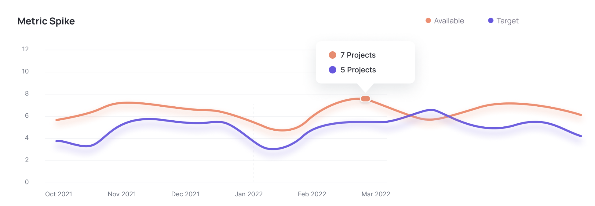
Operation Analytics and Investigating Metric Spike
By: Abhishek Kumar

Slide 2
CONTENTS
Project Description
Approach
Tech-Stack Used
Insights
Result

Slide 3
PROJECT DESCRIPTION
With the help of operation analytics, the company can find the areas on which it must improve upon. Being one of the most important parts of a company, this kind of analysis is further used to understanding between cross-functional teams, and more effective workflows. Investigating metric spike is also an important part of operation analytics as being a Data Analyst we must be able to understand or make other teams understand questions like- Why is there a dip in daily engagement? Why have sales taken a dip? Etc. Questions like these must be answered daily and for that it’s very important to investigate metric spike.
Working for a company like Microsoft designated as Data Analyst Lead and is provided with different data sets, tables from which I must derive certain insights out of it and answer the questions asked by different departments.

Slide 4
APPROACH
4
Database creation : Created and inserted the values in the database using the DDL & DML SQL queries provided by the product manager(as per project) in the MySQL database using MySQL workbench.
Extraction of insights : After creating the database required insights are generated from the database tables by running SQL queries in MySQL workbench.
Operation Analytics and Investigating Metric Spike

Slide 5
TECH-STACK USED
5
Used MySQL Community Server - GPL Version 8.0.36.0 and Connector Version C++ 8.0.36.0 for creating my project as MySQL Community Server - GPL is a free and open-source relational database management system that uses SQL.
Operation Analytics and Investigating Metric Spike

Slide 6
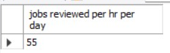
INSIGHTs
Case Study 1 (Operation Analytics)
Number of jobs reviewed: Amount of jobs reviewed over time.task: Calculate the number of jobs reviewed per hour per day for November 2020?
WITH jobs_review_per_hr AS (SELECT ds AS "review date", Round(Count(job_id) / Sum(time_spent) * 3600) AS "review_per_hr" FROM job_data WHERE Month(ds) = 11 GROUP BY ds) SELECT Round(Sum(review_per_hr) / 30) AS "jobs reviewed per hr per day" FROM jobs_review_per_hr;

Slide 7
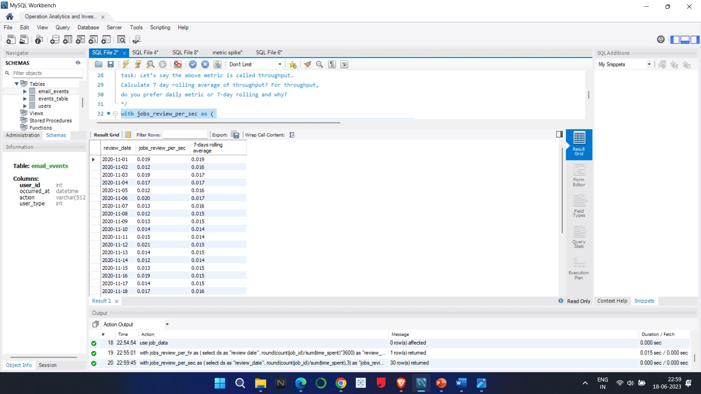
INSIGHTS
Throughput: It is the no. of events happening per second.task: Let’s say the above metric is called throughput. Calculate 7 day rolling average of throughput? For throughput,do you prefer daily metric or 7-day rolling and why?
WITH jobs_review_per_sec AS (SELECT ds AS "review_date", Round(Count(job_id) / SUM(time_spent), 3) AS "jobs_review_per_sec" FROM job_data WHERE Month(ds) = 11 GROUP BY ds) SELECT *, Round(Avg(jobs_review_per_sec) over(ORDER BY review_date ROWS BETWEEN 6 preceding
AND CURRENT ROW),3) AS "7-days rolling average" FROM jobs_review_per_sec;

Slide 8
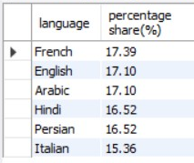
INSIGHTS
Percentage share of each language: Share of each language for different contents.task: Calculate the percentage share of each language in the last 30 days?
SELECT language, Round(Count(*) / Sum(Count(*)) OVER() * 100, 2) AS "percentage share(%)" FROM job_data WHERE Month(ds) = 11 GROUP BY language ORDER BY Round(Count(*) / Sum(Count(*)) OVER() * 100, 2) DESC;

Slide 9
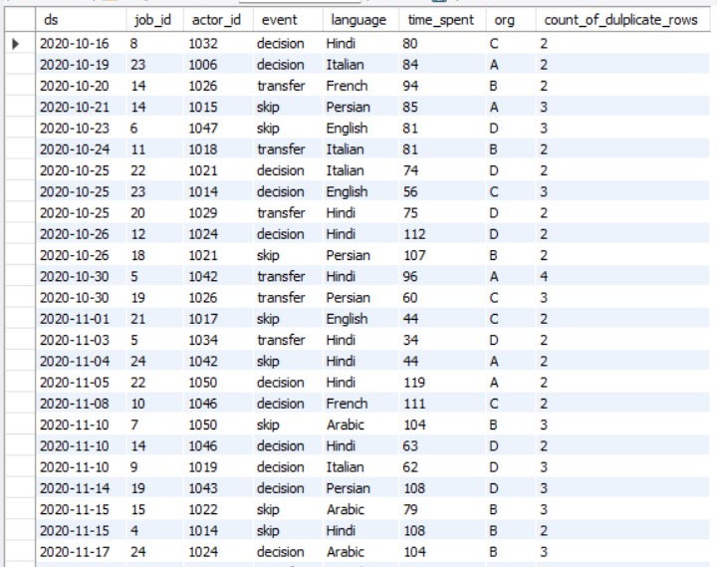
INSIGHTS
Duplicate rows: Rows that have the same value present in them.task: Let’s say you see some duplicate rows in the data. How will you display duplicates from the table?
SELECT *, Count(*) AS "count_of_dulplicate_rows" FROM job_data GROUP BY ds, job_id, actor_id, event, language, time_spent, org HAVING Count(*) > 1;

Slide 10
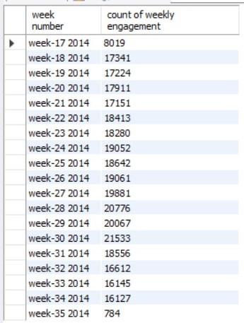
INSIGHTS
Case Study 2 (Investigating Metric Spike)
User Engagement: To measure the activeness of a user. Measuring if the user finds quality in a product/service.Your task: Calculate the weekly user engagement?
SELECT Concat("week-", Week(occurred_at), ” ”, Year(occurred_at)) AS "week number", Count(user_id) AS "count of weekly engagement" FROM events_table WHERE event_type = "engagement" GROUP BY 1 ORDER BY 1;

Slide 11
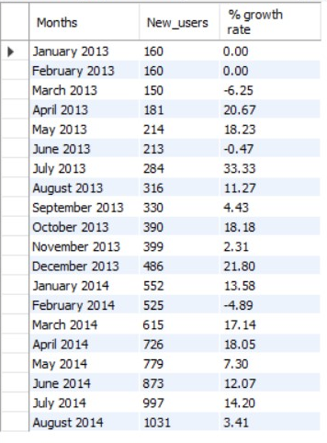
INSIGHTS
User Growth: Amount of users growing over time for a product.Your task: Calculate the user growth for product?
WITH new_active_users AS (SELECT Date_format(activated_at, "%m %y") AS "Months", Count(user_id) AS "New_users" FROM users WHERE state = "active" GROUP BY 1) SELECT *, Round(( new_users / Lag(new_users, 1, 160) OVER(ORDER BY "months") - 1 ) * 100, 2)
AS "% growth rate" FROM new_active_users

Slide 12
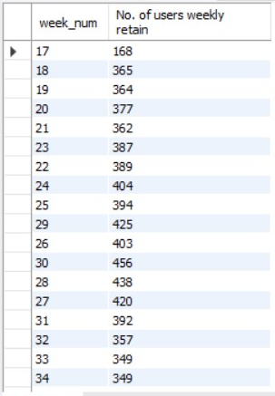
INSIGHTS
Weekly Retention: Users getting retained weekly after signing-up for a product.Your task: Calculate the weekly retention of users-sign up cohort?
WITH signup_users AS (SELECT user_id, Week(occurred_at) AS "sign_up_week" FROM events_table WHERE event_type = "signup_flow" AND event_name = "complete_signup"), engagement_users AS (SELECT user_id, Week(occurred_at) AS "first_engagement_week" FROM events_table WHERE event_type = "engagement"), cal_table AS (SELECT e.user_id, e.first_engagement_week AS "week_num", first_engagement_week - sign_up_week AS "retention_week" FROM engagement_users e LEFT JOIN signup_users s ON e.user_id = s.user_id) SELECT week_num, Sum(CASE WHEN retention_week = 1 THEN 1 ELSE 0 END) AS "No. of users weekly retain" FROM cal_table GROUP BY week_num ORDER BY week_num;

Slide 13
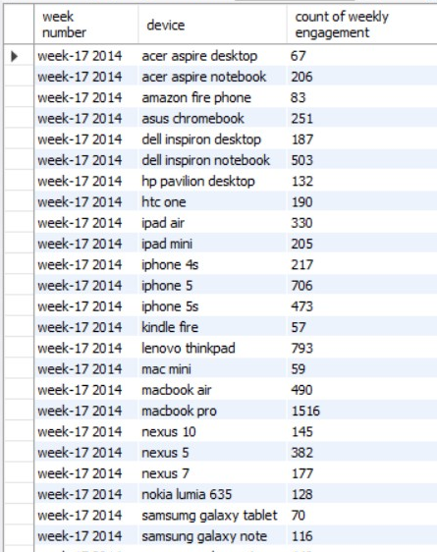
INSIGHTS
Weekly Engagement: To measure the activeness of a user. Measuring if the user finds quality in a product/service weekly.Your task: Calculate the weekly engagement per device?
SELECT Concat("week-", Week(occurred_at), "", Year(occurred_at)) AS "week number", device, Count(user_id) AS "count of weekly engagement" FROM events_table WHERE event_type = "engagement" GROUP BY 1, 2 ORDER BY 1, 2;

Slide 14
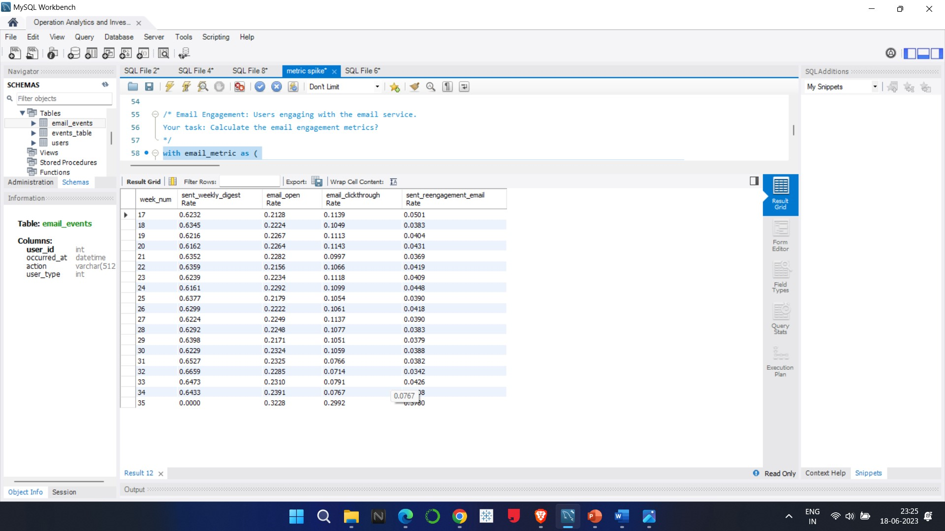
INSIGHTS
Email Engagement: Users engaging with the email service.Your task: Calculate the email engagement metrics?
WITH email_metric AS (SELECT Week(occurred_at) AS week_num, CASE WHEN action = 'sent_weekly_digest' THEN 1 ELSE 0 END AS "sent_weekly_digest", CASE WHEN action = 'email_open' THEN 1 ELSE 0 END AS "email_open", CASE WHEN action = 'email_clickthrough' THEN 1 ELSE 0 END AS "email_clickthrough", CASE WHEN action = 'sent_reengagement_email' THEN 1 ELSE 0 END AS "sent_reengagement_email" FROM email_events) SELECT week_num, Avg(sent_weekly_digest) AS "sent_weekly_digest Rate", Avg(email_open) AS "email_open Rate", Avg(email_clickthrough) AS "email_clickthrough Rate", Avg(sent_reengagement_email) AS "sent_reengagement_email Rate" FROM email_metric GROUP BY week_num ORDER BY week_num;

Slide 15
RESULTS
15
In this project, I learned how to apply advanced SQL concepts like Windows Functions, etc. I understood how the real-world industry works. It helped me in mastering my SQL concepts. I learned how to ask the right questions given the circumstances. From the given data and questions, which columns to consider and how to find the valuable insights which help the business to grow. I learned how the company find different areas related to the company to improve it further. I got to know about investigating metric spike (why there is a boom and why there is a dip).
Operation Analytics and Investigating Metric Spike

Slide 16
THANK YOU

